Slide 1
Introduction to Assembly Language
Lecture 2

Slide 2
Intel IAPX88
Intel Advanced Processor Extension 88 (8088)
16-bit processor + 1 MB Memory
Accumulator and all registers of 16 bits

Slide 3
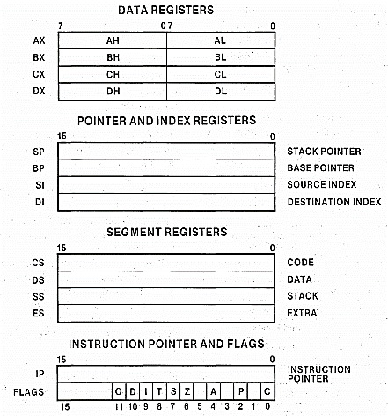
Register Architecture
The 8088 processor contains:
Thirteen 16-bit registers
Nine 1-bit flags
Why do we need Registers?
Having Address on address bus and corresponding data on data bus, we cannot read two operands at a time. Solution?
Temporary Storage i.e. Register

Slide 4
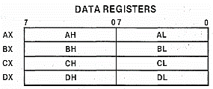
General Registers/Data Register File
The data registers can be addressed as either 8- or 16-bit registers.
16-bit registers are named AX, BX, CX, and DX
the 8-bit registers are named AL, AH, BL, BH, CL, CH, DL, and DH (the L or H suffix designates high-order or low-order byte).
The data registers participate interchangeably in both arithmetic and logical operations of the 8088.
AX: Accumulator Register
BX: Base Register
CX: Counter
DX: Destination in I/O operations
Notes:
Why do we need registers?
Registers are temporary storage places inside the processor
Relatively very small in number

Slide 5
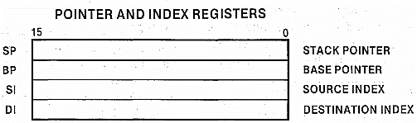
Index Registers (SI and DI)
hold address of data and used in memory access
Allow Arithmetic and logical operations
16-bit registers, cannot be used as 8-bit registers

Slide 6
Stack Pointer(SP) and Base Pointer(BP)
Both are memory pointers, contain addresses
Will be explored later

Slide 7
Instruction Pointer (IP)
Special register containing the address of the next instruction to be executed
Cannot be used directly
No mathematics or memory access can be done through this register
Program control instructions change the IP register implicitly

Slide 8

Flags Register
C, Carry Flag
P, Parity Flag
A, Auxiliary Carry
Z, Zero Flag
S, Sign Flag
T, Trap Flag
I, Interrupt Flag
D, Direction Flag
O, Overflow Flag
Notes:
Reference: Lecture Notes Chapter 1, Page 12

Slide 9
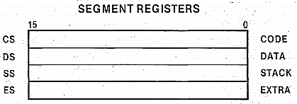
Segment Registers

Slide 10
Our First Program
Example 1.1
; a program to add three numbers using registers
[org 0x0100] ;we will see org directive later
mov ax, 5 ; AX = 5
mov bx, 10 ; BX = 10
add ax, bx ; AX = AX + BX
mov bx, 15 ; BX = 15
add ax, bx ; AX = AX + BX
mov ax, 0x4c00 ;terminate the program
int 0x21

Slide 11
Our First Program – Detail of Listing File
Assembly Code | Offset of Instructions | Machine Code | Opcode | Operand
; a program to add three numbers using registers
[org 0x0100]
mov ax, 5 ; load first number in ax | 0 | B80500 | B8 | 0500
mov bx, 10 ; load second number in bx | 3 | BB0A00 | BB | 0A00
add ax, bx ; accumulate sum in ax | 6 | 01D8 | 01D8
mov bx, 15 ; load third number in bx | 8 | BB0F00 | BB | 0F00
add ax, bx ; accumulate sum in ax | B | 01D8 | 01D8
mov ax, 0x4c00 ; terminate program | D | B8004C | B8 | 004C
int 0x21 | 10 | CD21 | CD | 21
TO DO:
- [org 0x0100]
- Watch Program in AFD Memory (M1 DS:0100, M2 DS:0100)
- Size of COM File
HEX of 5, 10 and 15 → 0005, 000A, 000F VS 0500, 0A00, 0F00
4C00 VS 004C
0x21 → 21
Notes:
Little Endian VS Big Endian
B80500
(1011 1000 0000 0101 0000 0000 )

Slide 12
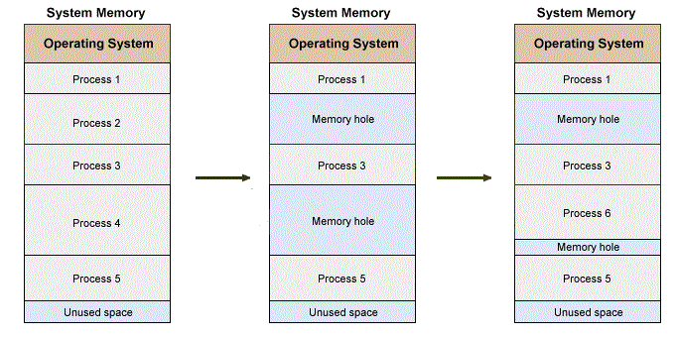
Processes in Main Memory

Slide 13
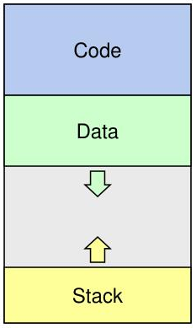
Memory Layout of a Process

Slide 14
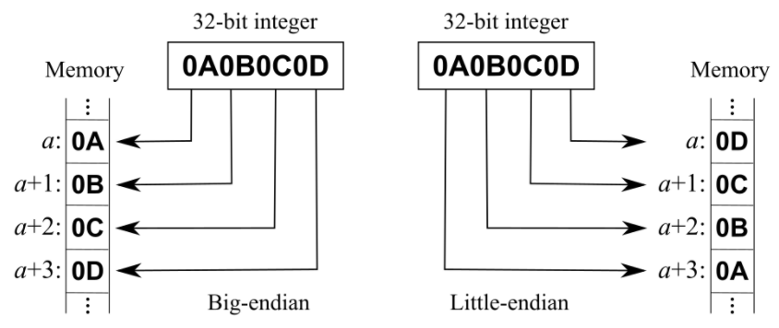
Little Endian VS Big Endian
Reading from base Address
0A0B0C0D
Reading from base Address
0D0C0B0A
MSB
LSB
LSB
MSB
How you will write “ABCD0123EF” in Big Endian and Little Endian?
“AB CD 01 23 EF”
“EF 23 01 CD AB”

Slide 15
References
Chapter 1 of Lecture Notes (1.1 to 1.6)
iAPX88 Manual
http://www.mathcs.emory.edu/~cheung/Courses/255/Syllabus/4-intro/mem-access.html

